Slide 1
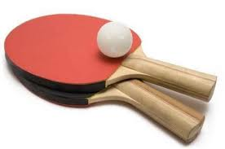
Ping pong music
CS 1610: Computing in the arts
Final project
By
Philip Kinasha (pak76)

Slide 2
Inspiration:
Noisy ping pong
Irregularity of rallies
Training motivation

Slide 3
Ping pong music :
Sensors in paddles
Random tune generation
Tune harmonizing

Slide 4
How it works:
I CEG
III BEG
VI CEA
V BDG
Distance 1
IV CFA
VII BDF
I
II DFA
V
IV
Distance 2
II
VII
VI
III

Slide 5
Demo

Slide 6
Questions…?

